Slide 1


How many Best-selling books were made into Movies?

Slide 2
Process
1
2
3
Data harvesting
Compilation of data
Draw conclusions
Notes:
1.
2.
3.

Slide 3




Methods used
Python & Jupyter notebook
HTML Web Scrape
API Web Scrape
Already sourced data (kaggle.com)
PostgreSQL
Tableau

Slide 4
What is a Best-seller?
Bestseller
noun
best·​sell·​er ˈbes(t)-ˈse-lər
variants or best seller
pluralbestsellers or best sellers
: a popular product and especially a book whose sales are among the highest of its class
Garet Book
Notes:
1. determine what constitutes a bestselling book.
ex: webster dictionary
You have to sell at least 5,000 books in a week, or maybe 10,000. Beyond that, things get complicated depending on which list you’re looking to end up on, THIS INCLUDES PRE-SALES.

Slide 5
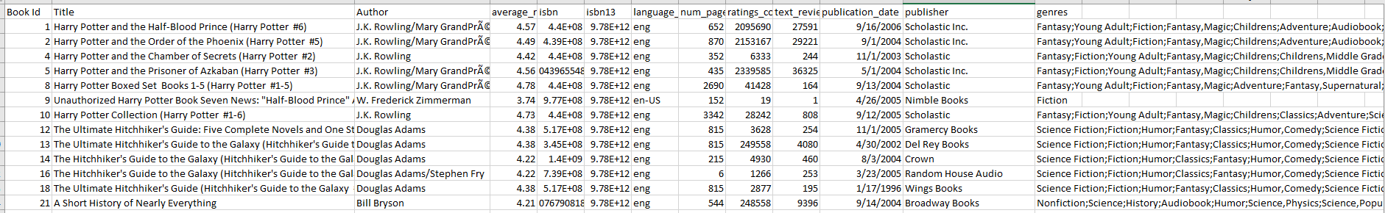
Goodread's Data
11,128 rows of data
Notes:
List includes multiple languages, not just English language books.
English language books = 10,320
Data sourced from Kaggle.com

Slide 6
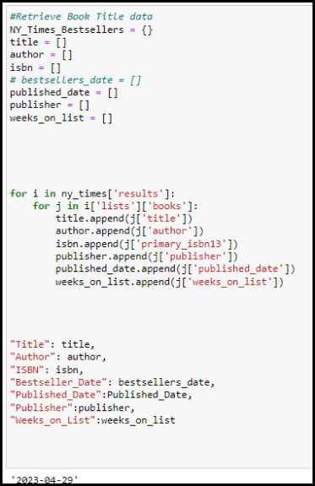
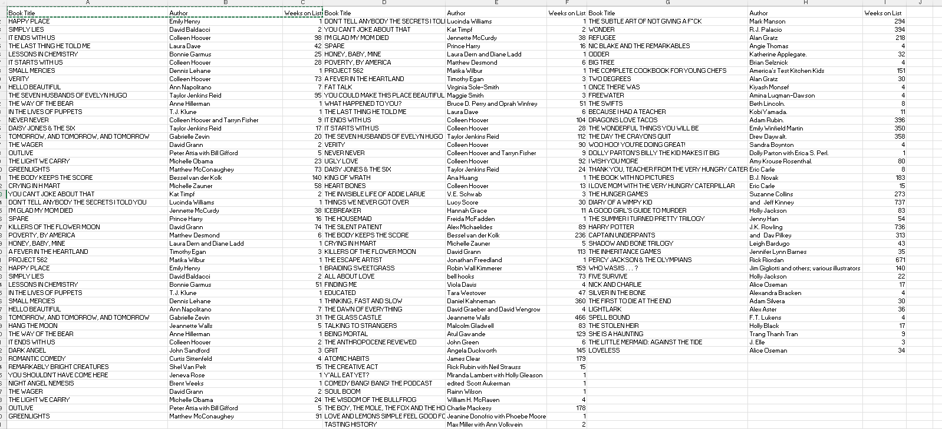

NYT Bestselling books
(as of 5/3/2023)
NYTime bestseller list originated in 1931
There are appox 155 Books on
this list every week
Notes:
As of May 2023, here are the number of categories and the approximate number of books on each of the current New York Times Best Seller lists:
*Combined Print & E-Book *Fiction: 15 books
*Combined Print & E-Book Nonfiction: 15 books
*Hardcover Fiction: 15 books
*Hardcover Nonfiction: 15 books
*Trade Fiction Paperback: 15 books
*Mass Market Paperback: 20 books
*Paperback Nonfiction: 15 books
*Advice, How-To & *Miscellaneous: 10 books
* Children's Middle Grade
* Hardcover: 5 books
* Children's Picture Books: 15 books
* Children's Series: 5 books
Young Adult Hardcover: 10 books
It's worth noting that the number of books on each list can fluctuate, especially during the holiday season when many new books are released. Additionally, the New York Times occasionally introduces or discontinues certain categories on their bestseller lists.

Slide 7
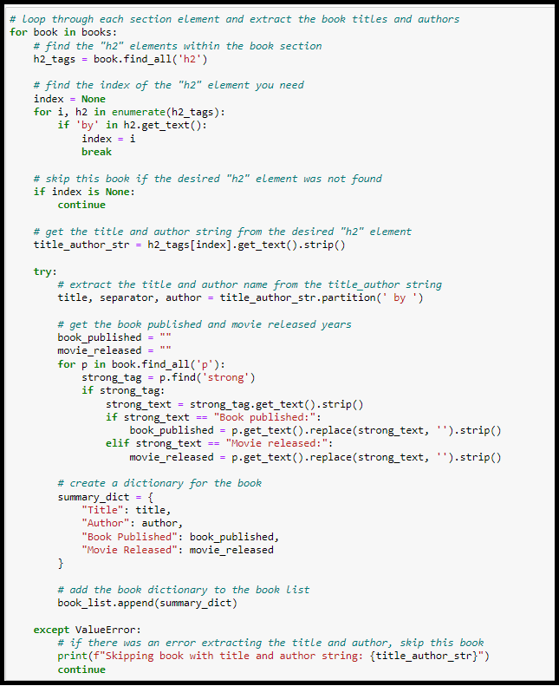
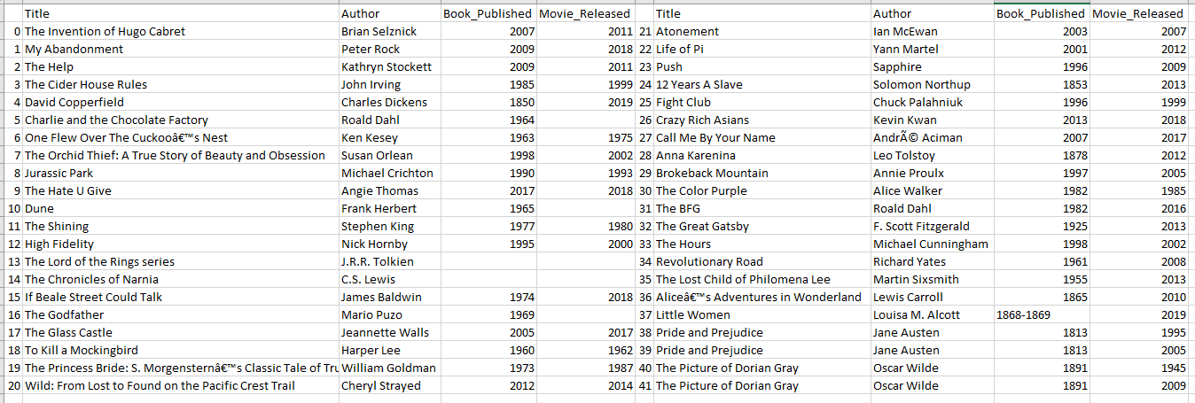
Reader's Digest
40 Books made to movies
List was last updated on May 12, 2023
Notes:
Additional data harvested: books- Reader's Digest.
Reader's Digest chose books that are best sellers, highly acclaimed, or otherwise influential to modern literature and pop culture. And the movies? Well, some stand on their own as fine works of art. Others were easily forgotten, though the books that inspired them endure in readers’ minds forever.

Slide 8
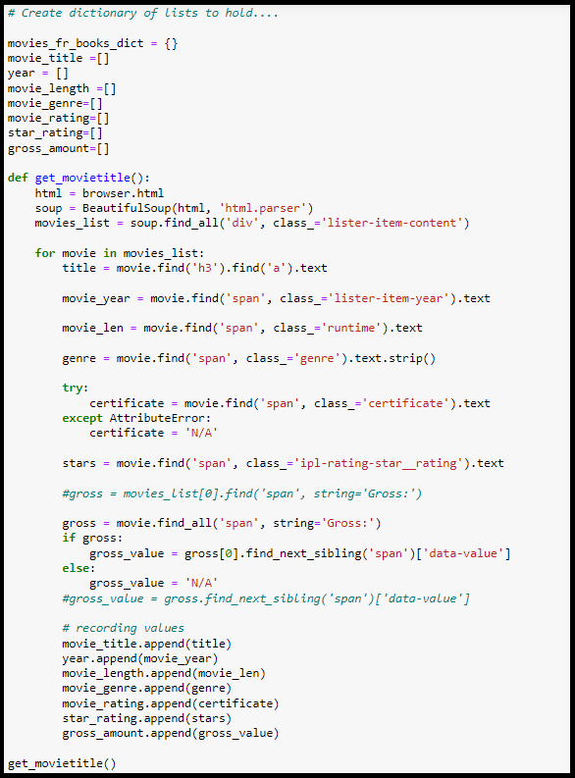
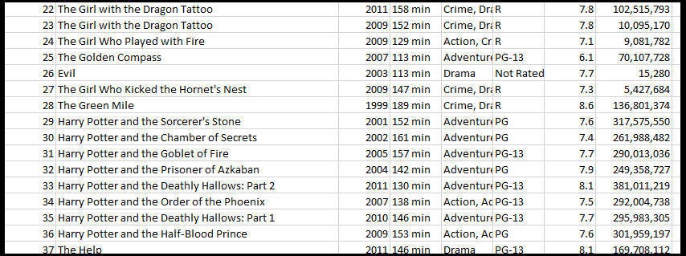
IMDB Data
Notes:
Girl with Dragon Tattoo listed twice because of country of origin. 2009 version released in Sweden, NY Times list does not exist in Sweden.
Cleaning.. etc
Before Cleanup, TOT rows of data was ?

Slide 9
Combined Print & E-Book Fiction: Approx. 15 books
Combined Print & E-Book Nonfiction: Approx. 15 books
Hardcover Fiction: Approx. 15 books
Hardcover Nonfiction: Approx. 15 books
Trade Fiction Paperback: Approx. 15 books
Mass Market Paperback: Approx. 20 books
Paperback Nonfiction: Approx. 15 books
Advice, How-To & Miscellaneous: Approx. 10 books
Children's Middle Grade Hardcover: Approx. 5 books
Children's Picture Books: Approx. 15 books
Children's Series: Approx. 5 books
Young Adult Hardcover: Approx. 10 books
231 - Total
vs.
168 New Total,
After Analyzing
Notes:
NY bestseller list from May 5, shows a total of 231 books. They are duplicated due to category, as they can fall into multiples.
After cleaning data only 168 was left.

Slide 10
So...
How many Best-selling books were made into Movies?
163
Notes:
capped at 163

Slide 11
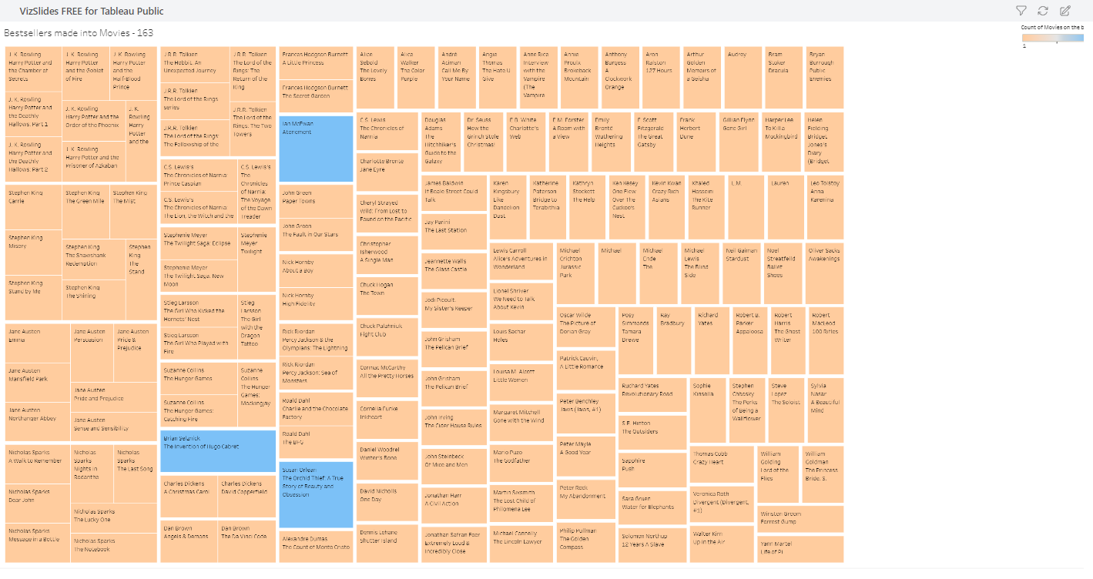
Bestsellers made into movies
(as of 5/3/2023)
Notes:
As of May 2023, here are the number of categories and the approximate number of books on each of the current New York Times Best Seller lists:
*Combined Print & E-Book *Fiction: 15 books
*Combined Print & E-Book Nonfiction: 15 books
*Hardcover Fiction: 15 books
*Hardcover Nonfiction: 15 books
*Trade Fiction Paperback: 15 books
*Mass Market Paperback: 20 books
*Paperback Nonfiction: 15 books
*Advice, How-To & *Miscellaneous: 10 books
* Children's Middle Grade
* Hardcover: 5 books
* Children's Picture Books: 15 books
* Children's Series: 5 books
Young Adult Hardcover: 10 books
It's worth noting that the number of books on each list can fluctuate, especially during the holiday season when many new books are released. Additionally, the New York Times occasionally introduces or discontinues certain categories on their bestseller lists.

Slide 12
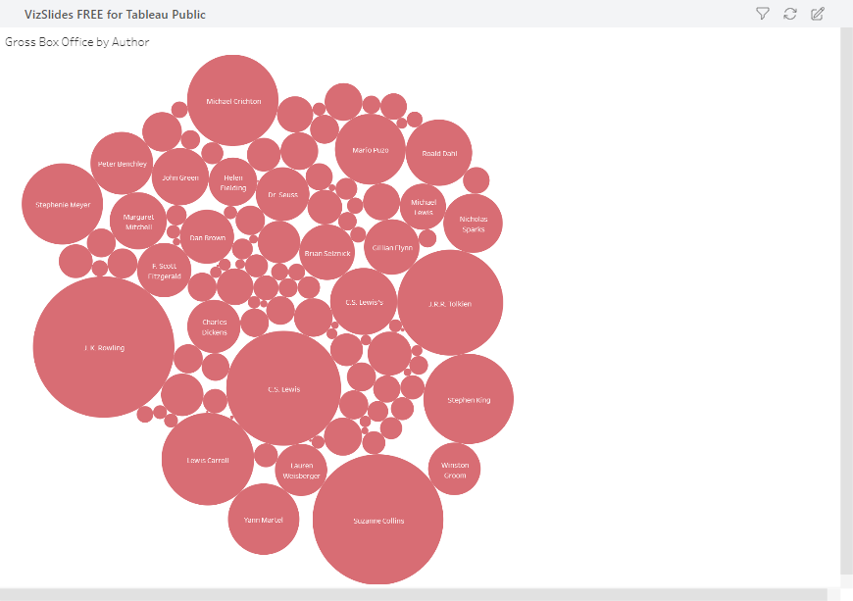
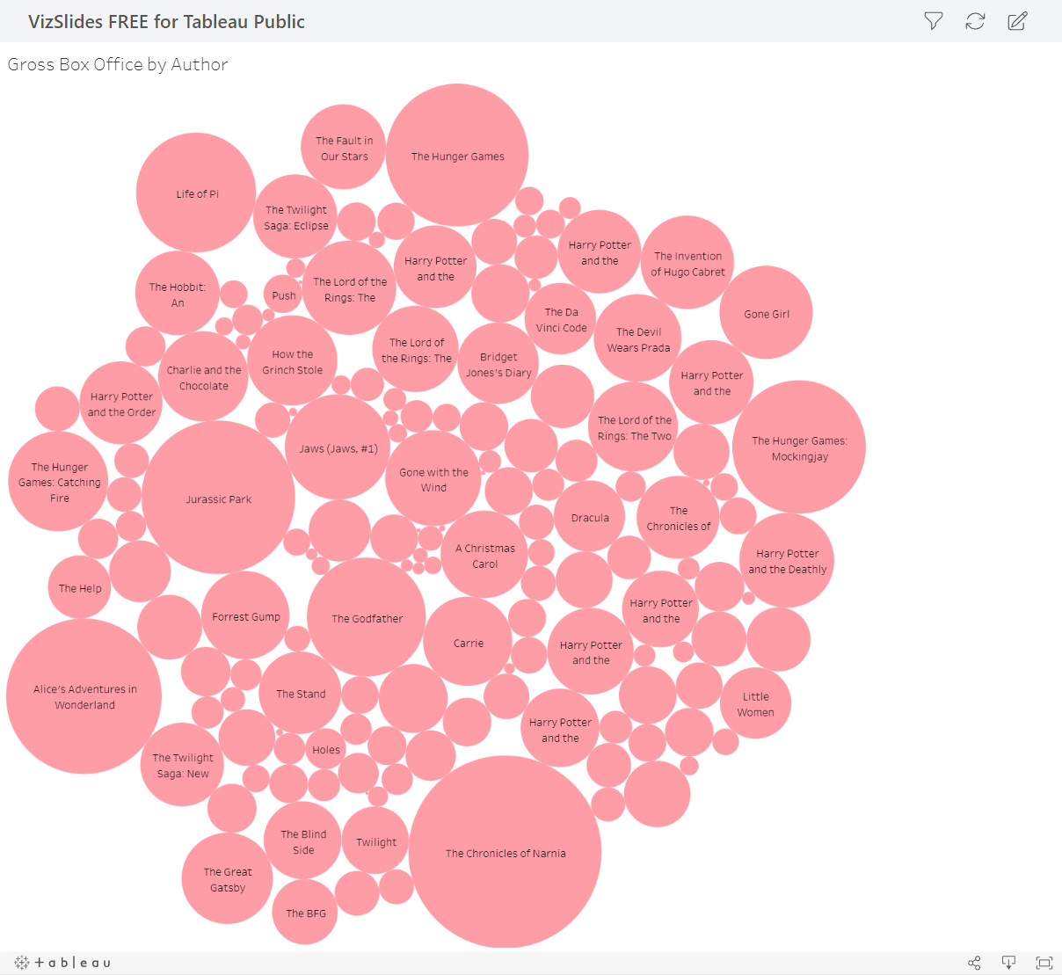
Box Office Gross - Author
Box Office Gross - Movie
Notes:
Gross Box office by Author
Gross Box office by Movie

Slide 13

Movies that are still curerntly on the Best Selling list
NY Times Bestselling List
Books made into movies
Movies currently on the list
THE HUNGER GAMES
DIARY OF A WIMPY KID
THE SUMMER I TURNED PRETTY TRILOGY
HARRY POTTER
PERCY JACKSON & THE OLYMPIANS
Notes:
book comparison of book datasets
OR
all books and movies

Slide 14
Challenges
1
2
3
Data doesn't Exists
Data was subjective
List is Duplicative
Notes:
1. Is limited to only Open Source, what's searchable.
1a. ex: The NY Times list didn't exist until 1931, resulting many favorites such as "A Christmas Carol" by Charles Dickens published in 1843, not getting the opportunity to appear on The NYBest Seller list during its initial publication.
~Another ex ALL Jane Austin books
~what are we saying here?
It's a movie from a book but not a best seller b/c most pop. books are not on the "list" due to capture time frame.
2. Some of the data Subjective to the proprietor: EX:
NY Times & Goodreads is subjective to the reviewers.
ex: Info can be or IS limited to origin (Ex. Country, Language)
~"They" capture what they want to capture.
3. DUP Data: For ex, NY Times has over 155 books at any given time, duplicating the results.
Why?
ex: Hardback vs. paperback, can hv multiple published dates, multiple adaptations for both movie/book,
Lots of opportunities to hv duplicate data.
Ex Mansfield Park

Slide 15
Additional Questions
01
02
03
04
Does a best seller affect the success of the movie?
Does a movie affect the success of a book?
Who would benefit having this data?
How many platforms do the movies exsist on?

Slide 16
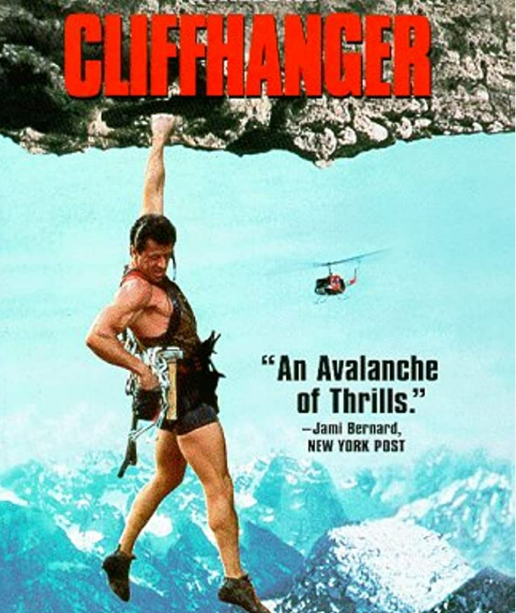
All excellent questions for further analysis another day.
Notes:
Who would benefit from this information.

Slide 17
Thank you.
Katie Kobus
Chanelle Toone
Elizabeth Mirabal
Notes:
Who would benefit from this information.

